Slide 1
ADIDAS SALES ANALYSIS
Business Requirements
Adidas intends to provide data-driven insights to its decision-makers,
enabling strategic growth and competitiveness in the changing sports and athletic business.
An improved grasp of sales dynamics and performance determinants.
Identifying geographical locations with high and low sales potential.
Insights on product performance can help with inventory and marketing decisions.
Informed pricing and margin strategies for increased profitability.
Actionable ideas for increasing sales and profits across several dimensions.

Slide 2
ADIDAS SALES ANALYSIS
Key Performance Index's (KPIs)
1. Total Sales
Total revenue generated from all products.
2. Total Units Sold
Total number of units sold across all product categories.
3. Total Profit
Total profit generated across all sales.
4. Average Price per Unit
The average selling price per unit across all products.
5. Average Profit Margin
The average operating margin across all sales.

Slide 3
ADIDAS SALES ANALYSIS
Visualization Through Charts
Performance Year wise and Month wise
Visualize the monthly and yearly sales and profit using a line chart
2. Performance State wise
Geographically represent total sales and profit using a map chart
3. Regine Wise Performance
Using a donate chart, to represent the contribution of various regions in total sale and total profit
4. Product Popularity
By a horizontal bar chart, to visualize the popular product in Adidas
5. Retailors Performance
Using a stack bar chart, to represent the different retailor contribution in sale and profit

Slide 4
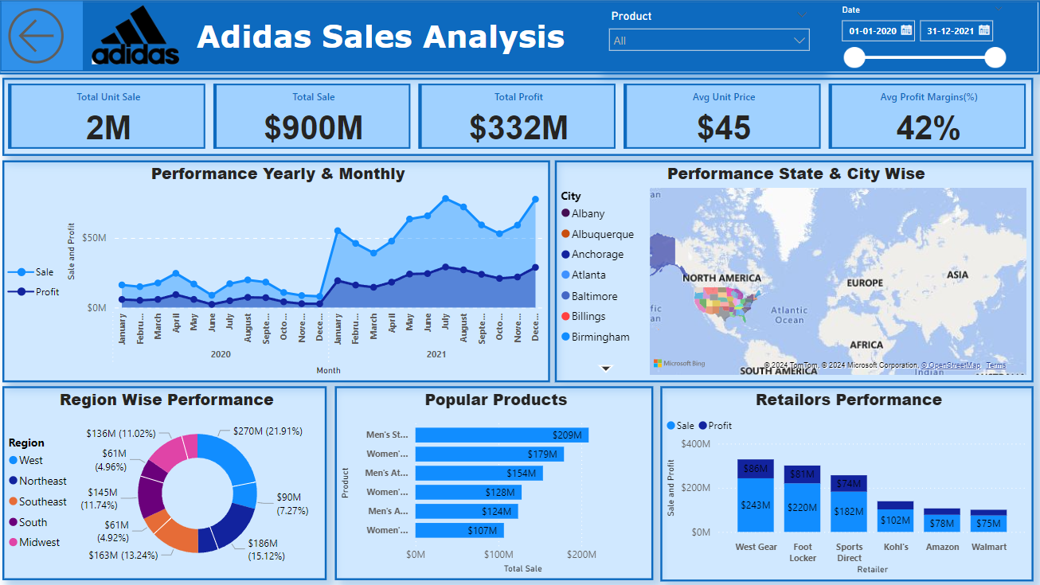

Slide 5
ADIDAS SALES ANALYSIS
Report of the Analysis
The dashboard provides a comprehensive view of Adidas' sales performance across various dimensions, including yearly and monthly trends, regional breakdowns, popular products, and retailer performance.
Sales and profits peaked in the first quarter of 2021.
There was a significant drop in sales and profits in the second half of 2020.
The West and Southeast regions have the highest sales and profits.
Men's products seem to be more popular than women's products.
Foot Locker and Sports Direct seem to be the top-performing retailers.

